Slide 1

Fusion between intelligent installations and IT world

Slide 2
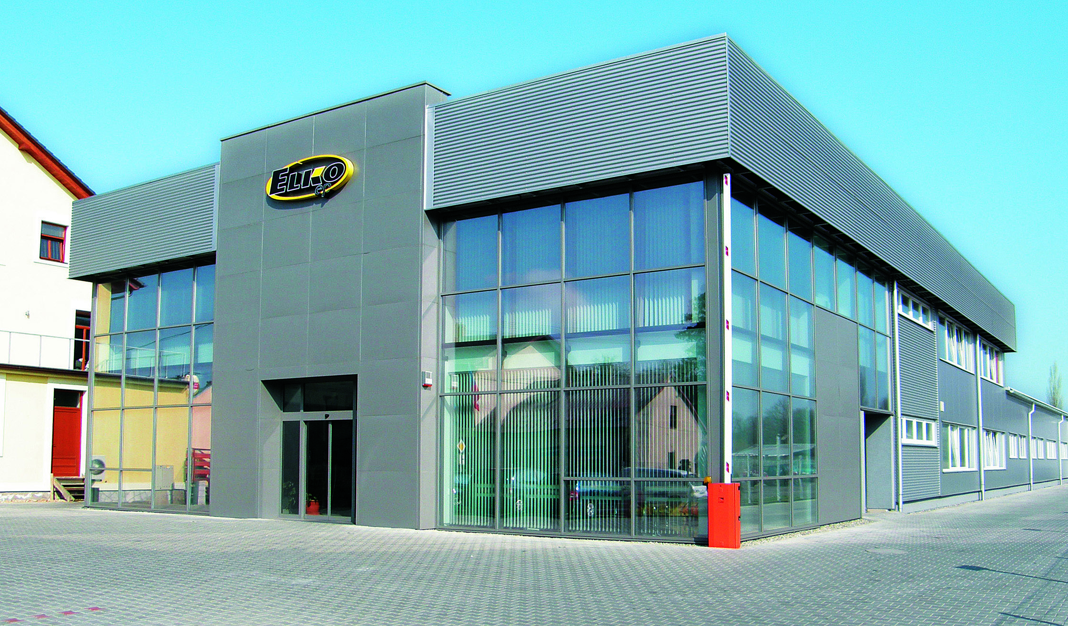
ELKO EP s.r.o. is a solely Czech company with 18 years of tradition. It is not only one of the biggest manufacturer of relays in Europe, but also a leader in home automation systems.

Slide 3
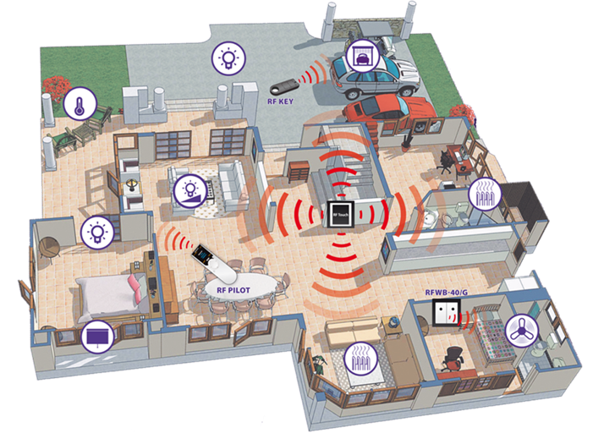
RF control system is an entry level intelligence installation perfect for refurbishing and retro-fitting

Slide 4
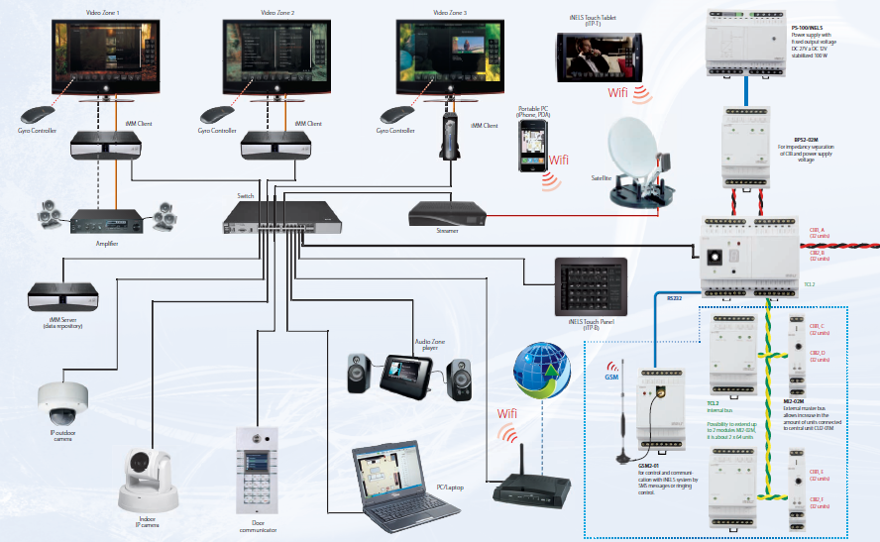
iNELS bus system with its multimedia extension can match even most demanding applications in the field of home automation and enterntaiment

Slide 5
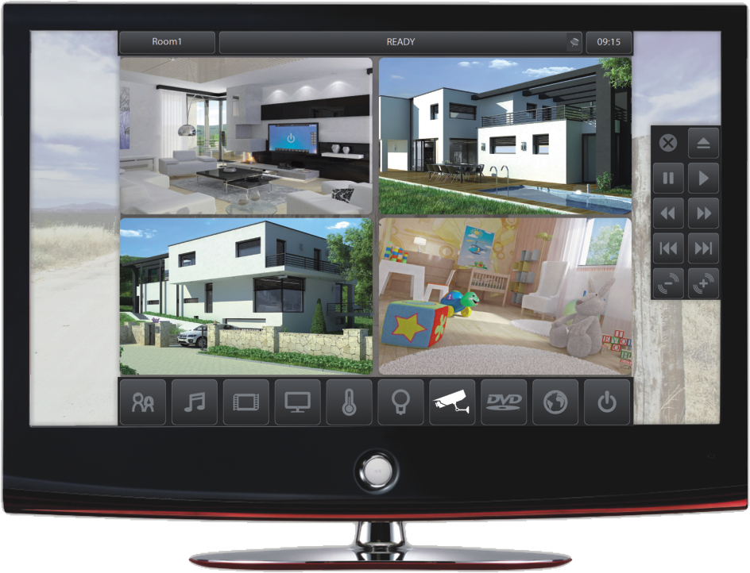
Pictures, music, videos, television, full control of all home technologies, cameras, internet everything can be controlled on TV screen

Slide 6

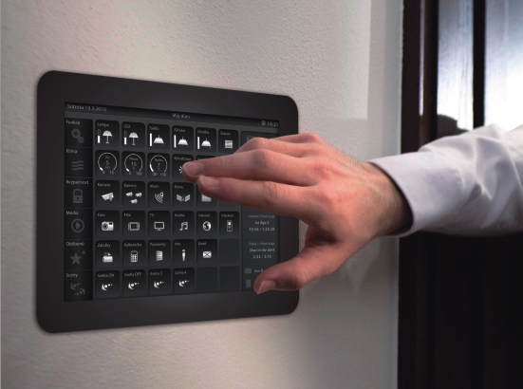
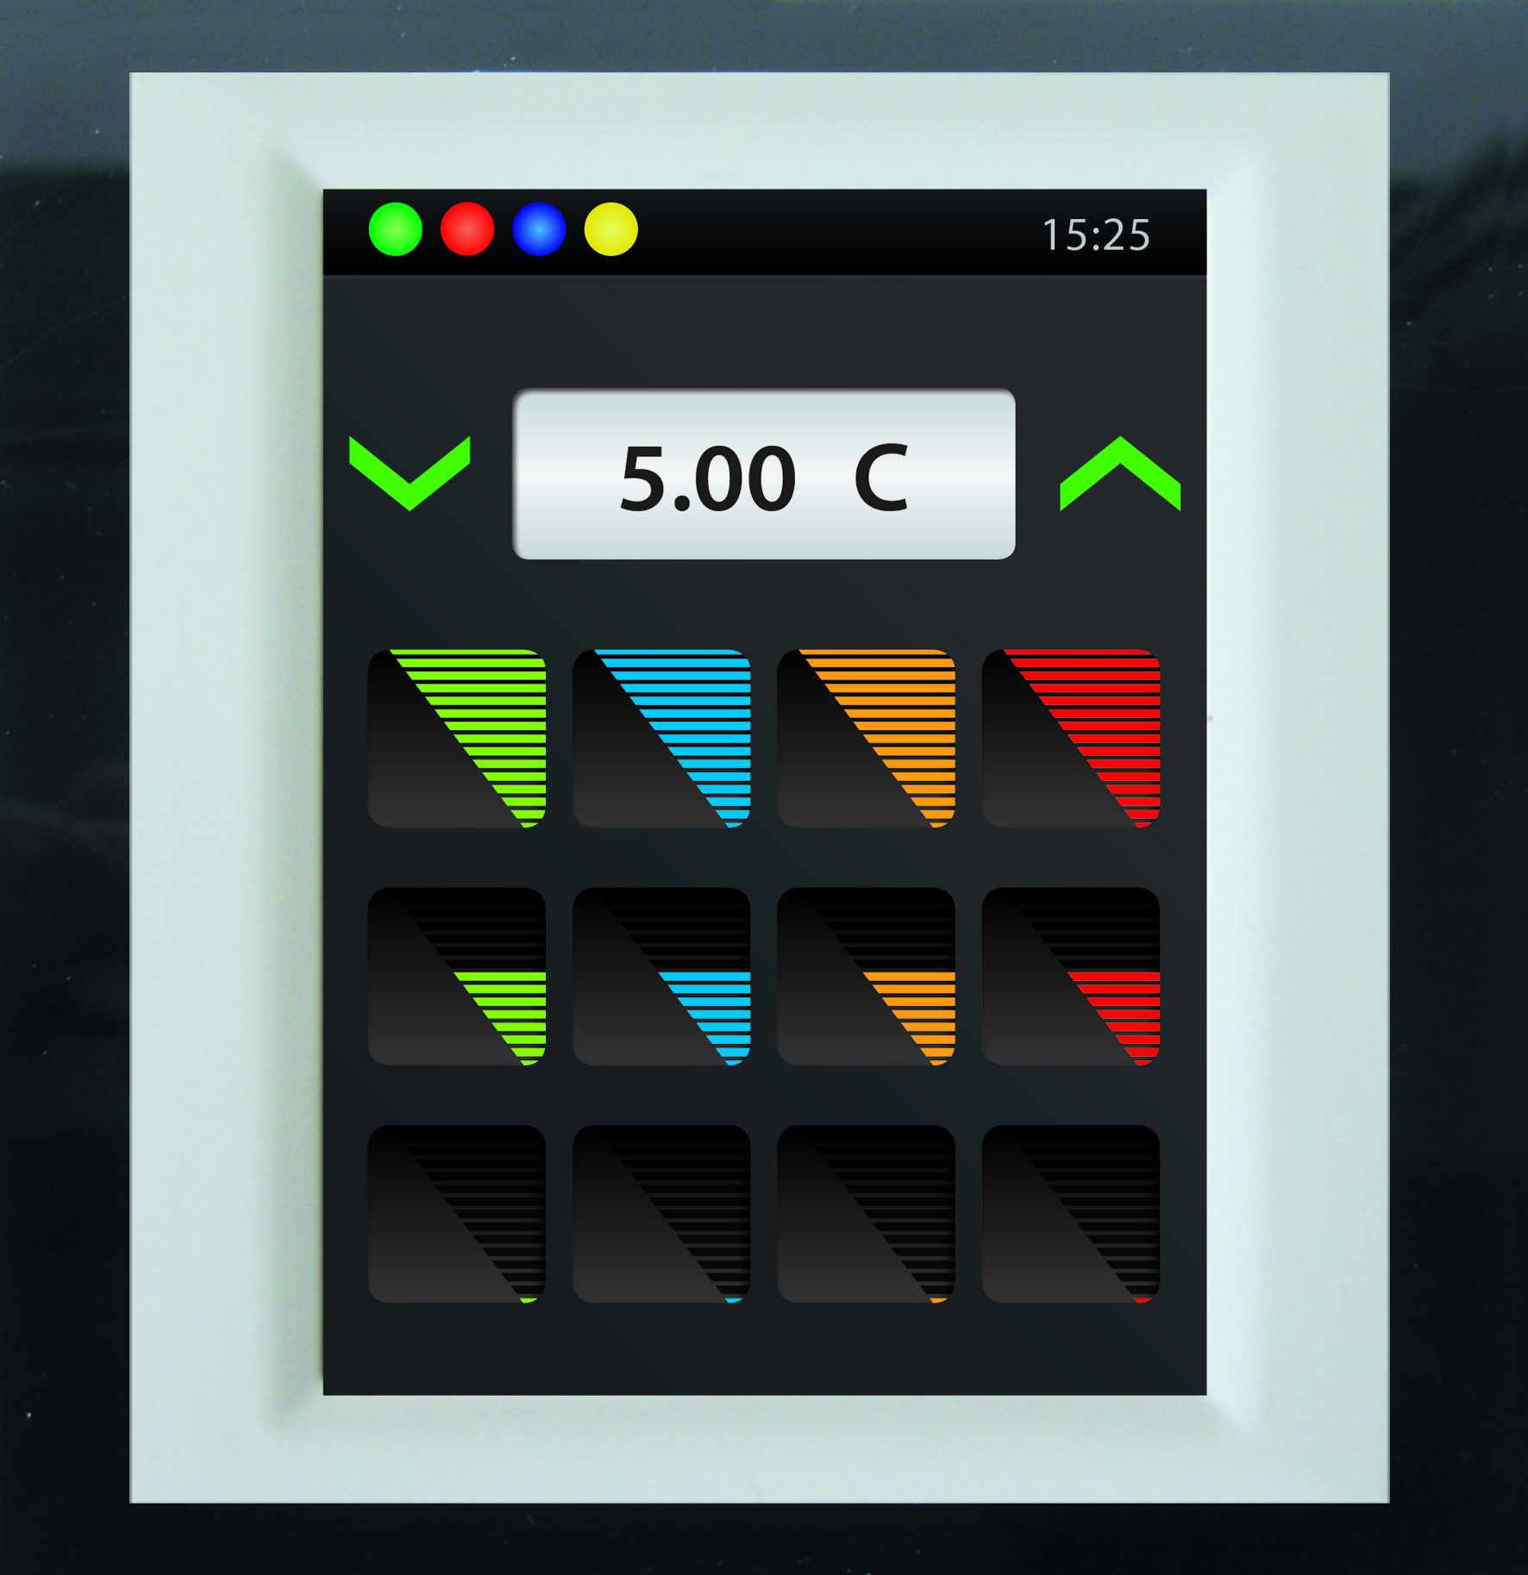
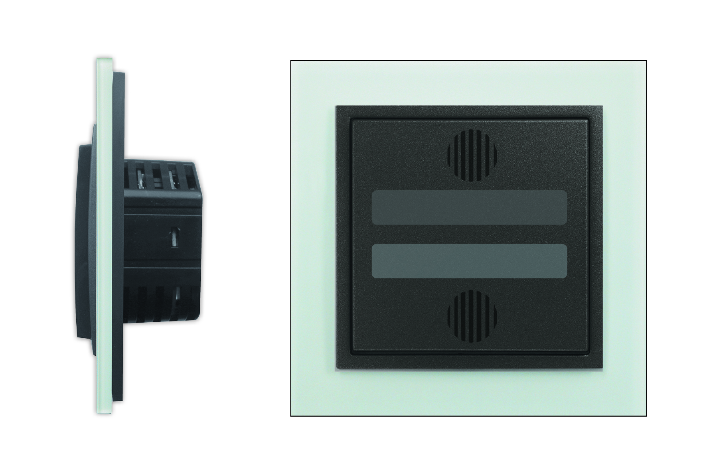
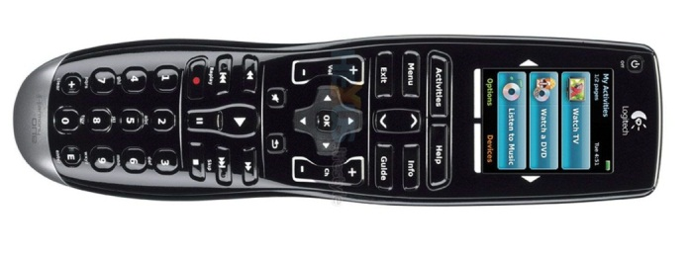
Or by many different ways such as with smart switches, remote controls, touch screens, tablets, GSM phones, voice control and many more…

Slide 7







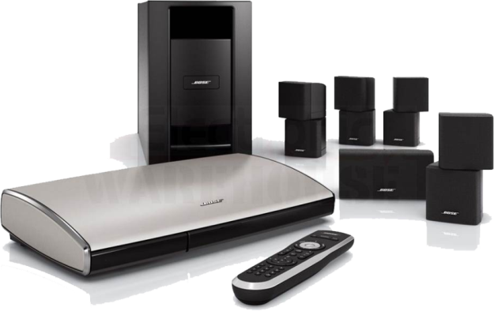
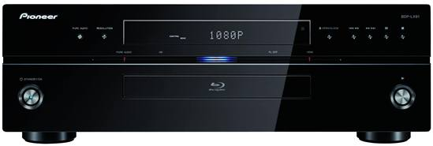
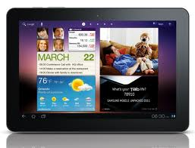
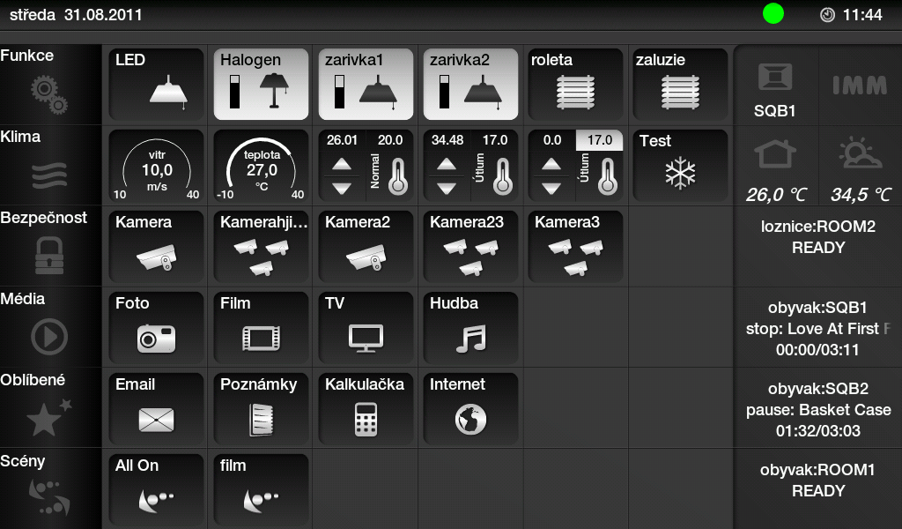
iNELS is already communicating with many leading brands and we are working hard to increase their number

Slide 8
We want to fulfil motto of our company :
www.elkoep.com
www.rfcontrol.com
www.inels.com
„ALWAYS SOMETHING MORE“

